Slide 1
APPLICATIONS OF LLM IN NLP
CCDS - NTU
DEC 2024
recurrent
Neural
networks
EDITING CANVA LINK HERE

Slide 2

What are rnns?
Introduction
RNNs are a class of neural networks adept at processing sequential data by maintaining a memory of previous inputs.

Slide 3
What are rnns?
Introduction
RNNs are a class of neural networks adept at processing sequential data by maintaining a memory of previous inputs.
They have a unique architecture where connections between nodes form a directed graph along a sequence, allowing them to retain information about previous
inputs through hidden states.

Slide 4
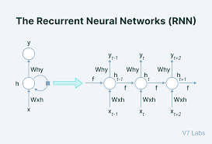
Why rnns?
RNNs are used for:
Natural Language Processing (NLP)
Speech Recognition
Machine Translation
Time-Series Forecasting
Sentiment Analysis
Sequential data, like sentences in a language or time-series stock data, requires models that understand dependencies across time or position

Slide 5
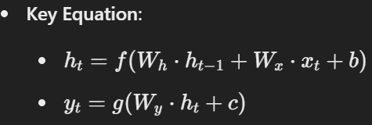
Overview of components
Input Layer: Accepts data at each time step.
Hidden State: Acts as memory, retaining information from previous time steps.
Output Layer: Produces predictions or classifications based on current hidden state and input.
Feedback Loop: Enables information persistence by passing hidden states to the next timestep.
Key Equation:

Slide 6
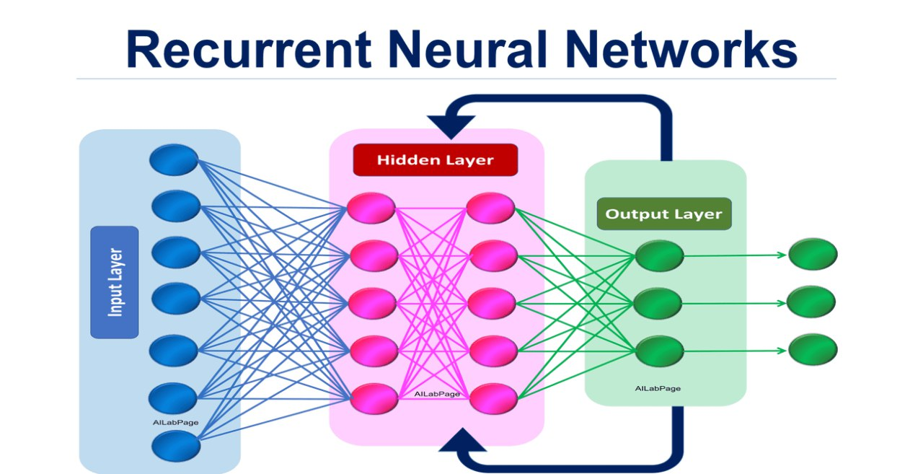
Basic rnn archtecture
RNNs have recurrent connections that loop back to themselves, forming a memory system.
At each time step, input and hidden state influence the output, which can then be fed back into the network.

Slide 7

MATHEMATICAL FOUNDATION
RNNs rely on mathematical formulations to compute:
Hidden State: Aggregates past information:
Output: Maps hidden state to predictions:
These equations make RNNs capable of sequential learning.

Slide 8
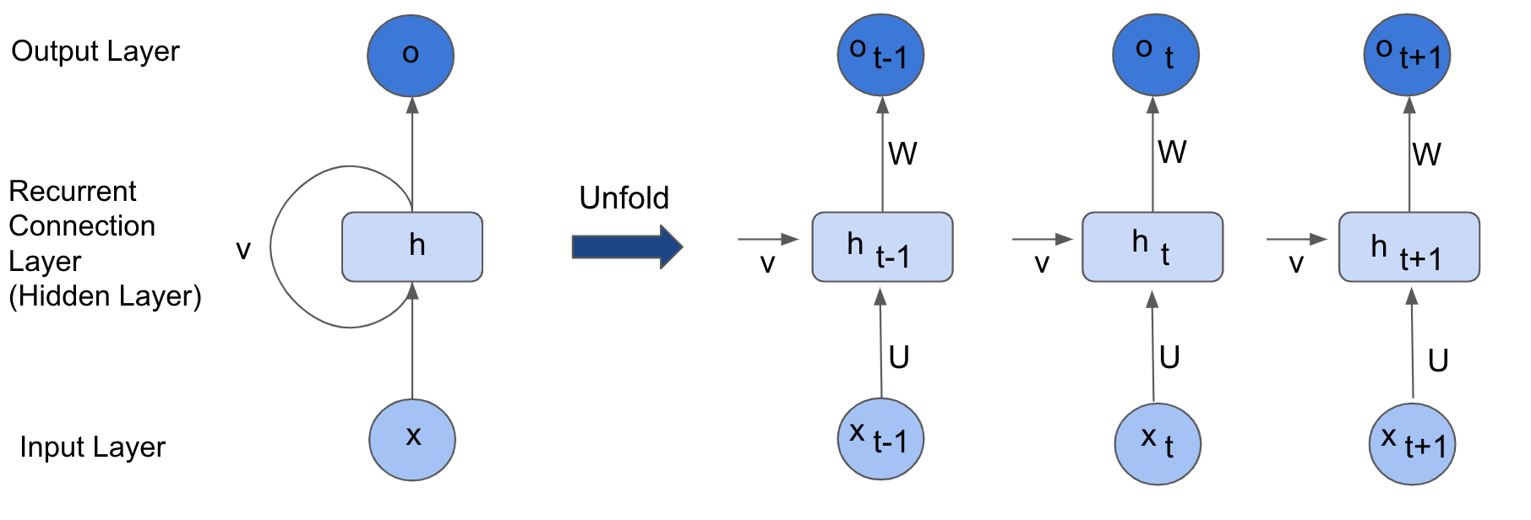
HIDDEN STATE MEMORY
The hidden state carries forward the learned information from previous timesteps.
This feature enables RNNs to "remember" the past, making them suitable for sequential data processing.

Slide 9
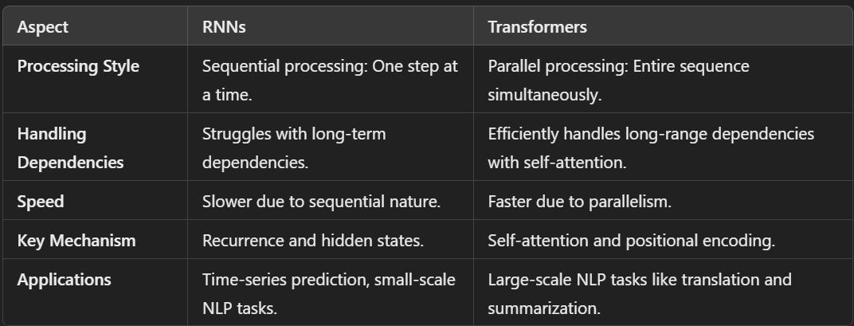
TRANSFORMERS VS RNN

Slide 10
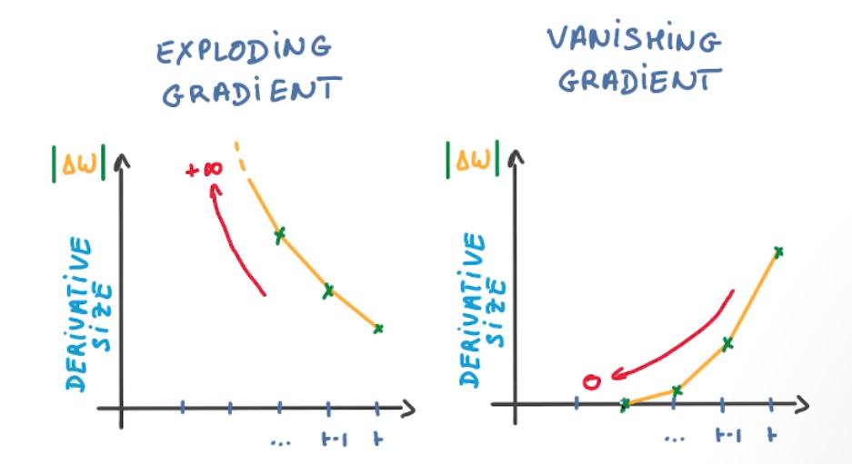
LIMITATIONS OF BASIC RNN
Vanishing Gradients: Gradients shrink exponentially during backpropagation, making it hard to learn long-term dependencies.
Exploding Gradients: Gradients grow too large, destabilizing training.

Slide 11
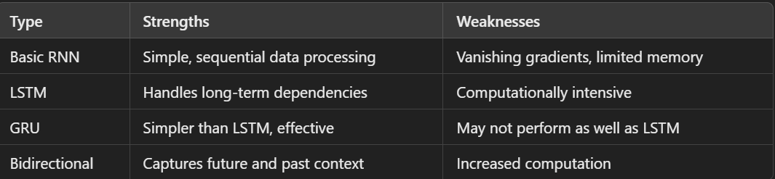
COMPARISONS OF RNN VARIANTS

Slide 12
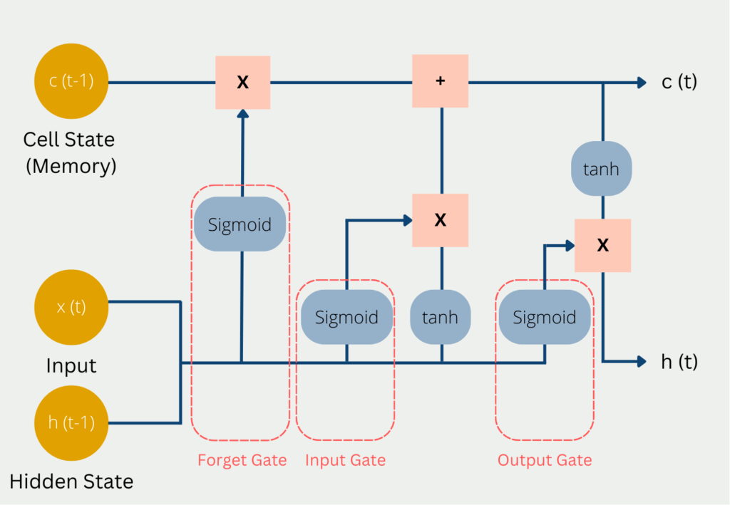
LSTM

Slide 13
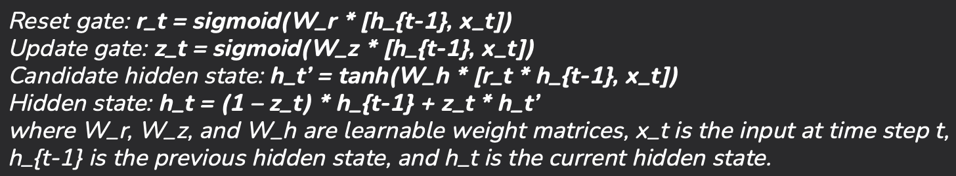
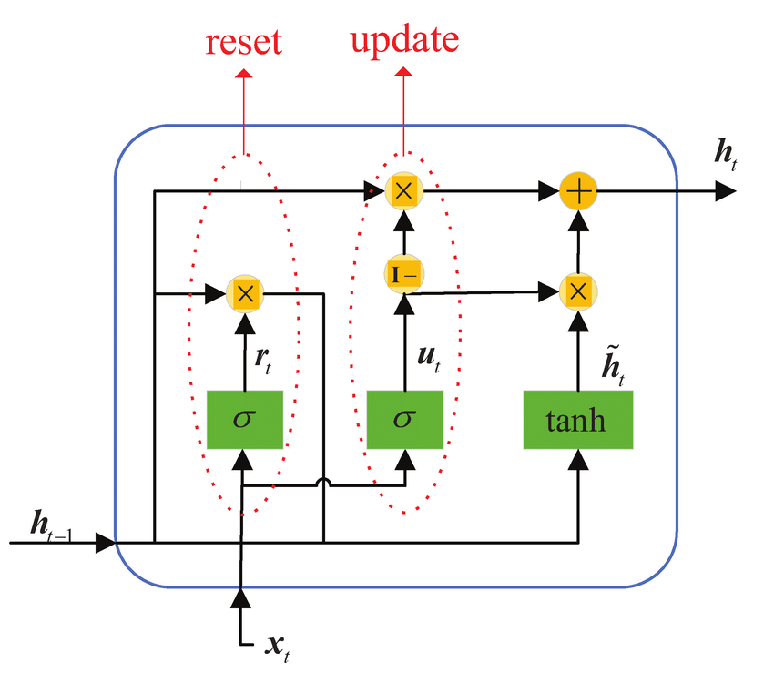
GRU

Slide 14
FUTURE DIRECTIONS OF RNN RESEARCH
Hybrid Architectures: Combine RNNs with Transformers for enhanced feature extraction and long-range context modeling.
Memory-Enhanced Models: Incorporate external memory (e.g., Memory Networks) to improve long-term dependency handling.
Efficient Training Techniques: Address vanishing gradients and computational overhead with methods like gradient clipping and advanced loss functions.
Domain-Specific Optimizations: Design RNNs for specialized tasks such as time-series analysis, music generation, and speech synthesis.
Sparse RNNs: Utilize sparsity in data to enhance computational efficiency and reduce training costs.

Slide 15
CONCLUSION
Recap
What we covered:
Fundamentals of RNNs, including their architecture, training, and applications.
Advanced variants like LSTM and GRU, highlighting their advantages.
Limitations of RNNs and how Transformers address these challenges.

Slide 16
CONCLUSION
Significance
RNNs remain a foundational tool in sequence modeling and have paved the way for many advanced architectures in AI.
Takeaways
While RNNs have limitations, they are still valuable for tasks requiring sequential data modeling.
Transformers have revolutionized the field, but RNNs hold promise for further
innovation.

Slide 17
THANK
YOU.

